Slide 1
bit coin price-prediction - LSTM

Slide 2
Overview
To provide analysis and predictions for investing in crypto currency given the investor's risk and investment profile.

Slide 3

Data Set
The data has been taken from the website 'WWW.twelvedata.com‘
From 1st Nov 2022 to 6th Dec 2022 at the interval of 5 min.

Slide 4
Structure of program
Twelve data API
5 min interval
Training the model using every 2 hours recurring data
Predicting bit coin price for the next hour
Deep learning : LSTM

Slide 5
Libraries
Pandas
Requests
Numpy
Matplotlib
Sklearn
Tensorflow

Slide 6
What is crypto currency
Crypto currency is a digital payment system that doesn't rely on banks to verify transactions. It’s a peer-to-peer system that can enable anyone anywhere to send and receive payments. Instead of being physical money carried around and exchanged in the real world, crypto currency payments exist purely as digital entries to an online database describing specific transactions. When you transfer crypto currency funds, the transactions are recorded in a public ledger. Crypto currency is stored in digital wallets

Slide 7
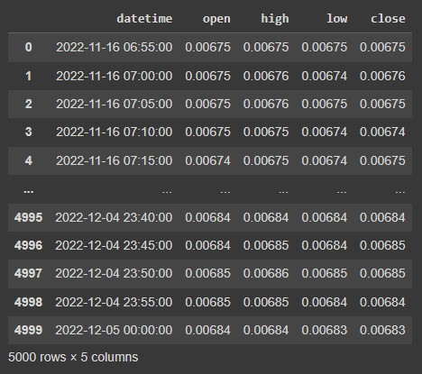
Information of data
DateTime : date and time of observation
Open : Opening price on the given day
High : Highest price on the given day
Low : Lowest price on the given day
Close : Closing price on the given day

Slide 8
Processing the data
Imported data from twelvedata.com and loaded in cell from 1st November to 1st December of 2022
By using requests and json function table is viewed reshaped for prediction.
We set 24 as time intervals to train i and 12 as prediction interval and we apply for loop to train the model.
We apply LSTM method for prediction and we set four layer with assigned number of 128,64,32, we use dropout function to reduce the loses.
Model is compiled with mean squared error and set epochs 10 with the batch size of 64

Slide 9
After the completion of the epochs it gives the accuracy as 0.0012 with the loss 0.0046.
Now lets test model with remaining date and predict the value.
With the test data the model as tested.
Now lets visualize using graph and see comparison.

Slide 10
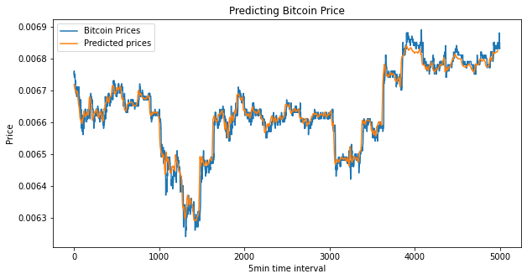
As we compare actual price and predicted price we come to know that the predicted value is near to the actual value and we conclude the model is good.
Now we predict the value for future and test the data
The model predict the values as 0.00682427

Slide 11
Thank you
Presented by : Vignesh L
Batch : PGA 24

